Slide 1
ECEG-5193: Algorithm Analysis and Design
Algorithm Design Techniques
Branch and Bound

Slide 2
Branch and Bound
Searching Strategies

Slide 3
Feasible Solution vs. Optimal Solution
DFS, BFS, … can be used to solve some searching problem for searching a feasible solution.
However, they cannot be used to solve the optimization problems for searching an (the) optimal solution.

Slide 4
The branch-and-bound strategy
This strategy can be used to solve optimization problems without an exhaustive search in the average case.

Slide 5
Branch-and-bound strategy
Two Mechanisms:
  A mechanism to generate branches when searching the solution space
  A mechanism to generate a bound so that many branches can be terminated

Slide 6
Branch-and-bound strategy
It is efficient in the average case because many branches can be terminated very early.
Although it is usually very efficient, a very large tree may be generated in the worst case.
Many NP-hard problem can be solved by B&B efficiently in the average case; however, the worst case time complexity is still exponential.

Slide 7
For Minimization Problems
∞
Upper Bound
(for feasible solutions)
Usually, LB<UB.
If LB≥UB, the expanding node can be terminated.
Optimal
Lower Bound
(for expanding nods)
0

Slide 8
For Maximization Problems
∞
Upper Bound
(for expanding nods)
Usually, LB<UB.
If LB≥UB, the expanding node can be terminated.
Optimal
Lower Bound
(for feasible solutions)
0

Slide 9
Basic Branch and Bound
Goal: Find Optimal path from T to D
E
1
A
D
1
G
5
9
3
11
T
V
8

Slide 10
Basic Branch and Bound
Lower Bound:
8
9
10
11
13
15
T
8
9
1
E
8
9
V
A
A
D
3
11
1
1
1
5
11
19
G
D
10
10
9
G
E
G
T
11
5
5
3
3
15
13
16
D
D
V
8
V
3
11
16
24
G
D
Not Efficient

Slide 11
Branch and Bound
Prune infeasible paths
T
8
9
8
9
V
A
3
11
1
1
11
19
G
D
10
10
G
E
5
5
3
13
15
D
V
16
D
3
11
16
24
G
D

Slide 12
Branch and Bound
Prune infeasible paths
T
T
8
9
8
9
8
9
V
A
8
9
V
A
3
11
1
1
3
11
1
1
11
19
10
10
11
19
G
D
G
E
10
10
G
D
G
E
5
5
3
16
15
13
5
3
15
13
D
D
V
D
V
3
11
16
24
G
D

Slide 13
Integer programming
Example: maximizing a function with given constraints.
z= 3x +2y.
5x + 6y ≤ 45
4x + 7y ≤ 42
Solution: x = 5.73, y= 2.73

Slide 14
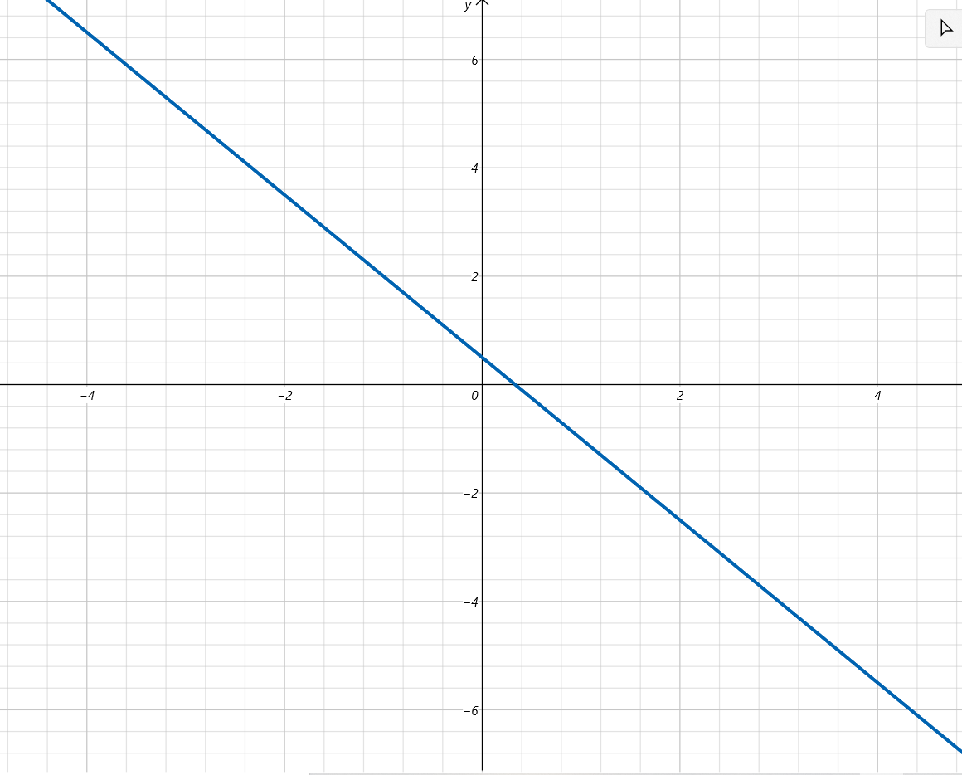
Integer programming
z = 3x +2y

Slide 15
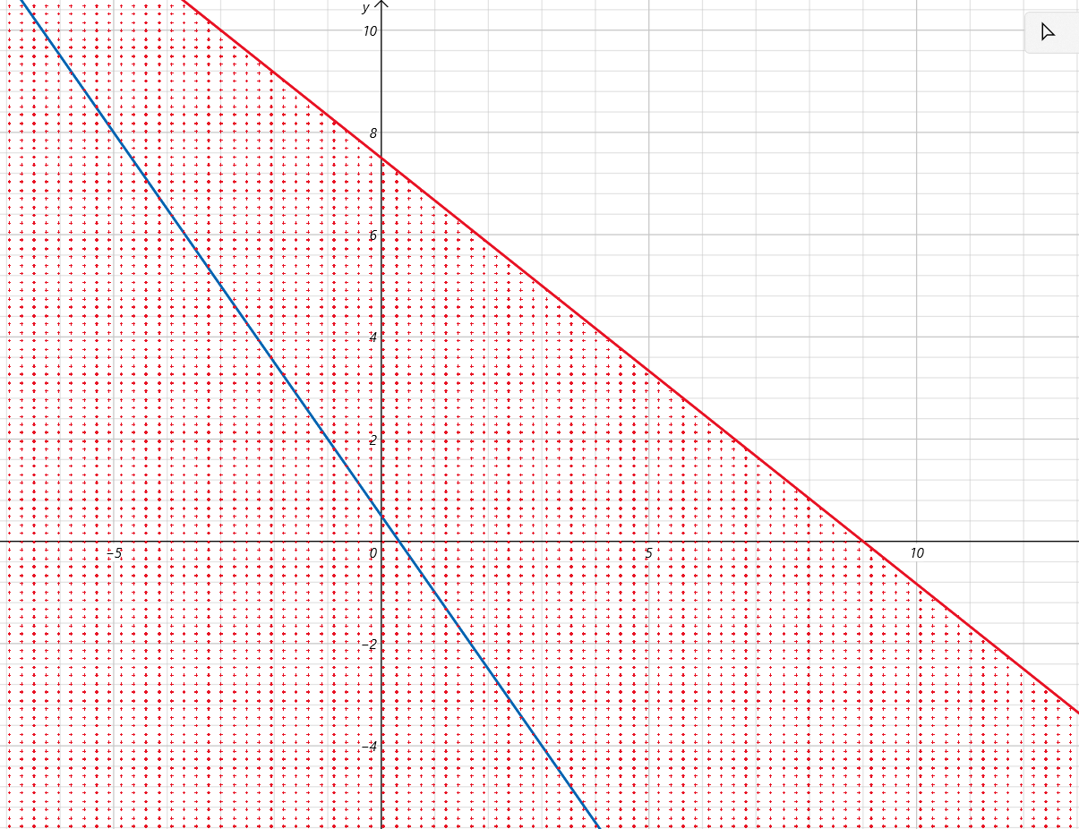
Integer programming
z = 3x +2y
5x + 6y ≤ 45

Slide 16
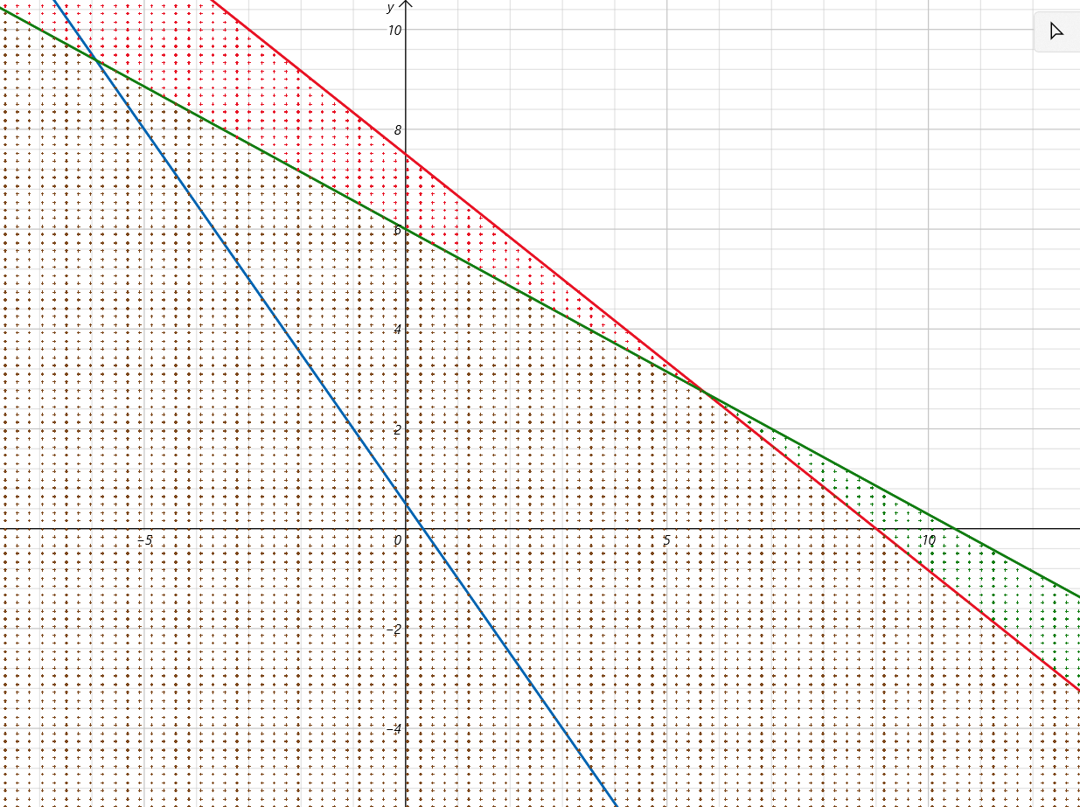
Integer programming
z = 3x +2y
5x + 6y ≤ 45
4x + 7y ≤ 42
6
x = 5.73
y = 2.73
4
2
0
5
10
How to find an integer solution?

Slide 17
Integer programming
z = 3x +2y
5x + 6y ≤ 45
4x + 7y ≤ 42
x = 5.73
y = 2.73
How to find an integer solution?
Let
x = 5 or 6
y = 2 or 3

Slide 18
Integer programming
z = 3x +2y
5x + 6y ≤ 45
4x + 7y ≤ 42
6
x = 5.73
y = 2.73
4
2
0
5
6
10
How to find an integer solution?

Slide 19
Integer programming
z = 3x +2y
5x + 6y ≤ 45
4x + 7y ≤ 42
x = 5.73
y = 2.73
z = 3x +2y
= 3*5.73) +2*2.73
= 22.65
We cannot do better than 22.65
Next best integer value is 22
Upper bound: 22
Lower bound:

Slide 20
Maximizing z with integers
z = 3x +2y
5x + 6y ≤ 45
4x + 7y ≤ 42
x = 5.73
y = 2.73
Upper bound:
Lower bound:
22
21.28
x = 5.73
y = 2.73
z = 22.65
x ≤ 5
x ≥ 6
x = 5
y = 2.73
z = 21.28
x = 6
y = 2.73
z = 17

Slide 21
Maximizing z with integers
z = 3x +2y
5x + 6y ≤ 45
4x + 7y ≤ 42
x = 5.73
y = 2.73
Upper bound:
Lower bound:
22
21.28
21
x = 5.73
y = 2.73
z = 22.65
x ≤ 5
x ≥ 6
x = 5
y = 2.73
z = 21.28
x = 6
y = 2.73
z = 17
y ≤ 3
y ≥ 4
x = 5
y = 3
z = 21
x = 5
y = 4
z =
5(5) + 6(4) = 49. Violates constraint

Slide 22
Maximizing z with integers
z = 3x +2y
5x + 6y ≤ 45
4x + 7y ≤ 42
x = 5.73
y = 2.73
Upper bound:
Lower bound:
22
21
x = 5.73
y = 2.73
z = 22.65
x ≤ 5
x ≥ 6
x = 5
y = 2.73
z = 21.28
x = 6
y = 2.73
z = 17
y ≤ 3
y ≥ 4
x = 5
y = 3
z = 21
x = 5
y = 4
z =
x ≤ 4
x = 4
y = 3
z = 18

Slide 23
Maximizing z with integers
z = 3x +2y
5x + 6y ≤ 45
4x + 7y ≤ 42
x = 5.73
y = 2.73
Upper bound:
Lower bound:
22
21
22
x = 5.73
y = 2.73
z = 22.65
x ≤ 5
x ≥ 6
x = 5
y = 2.73
z = 21.28
x = 6
y = 2.73
z = 17
y ≤ 3
y ≥ 4
x = 5
y = 3
z = 21
x = 5
y = 4
z =
y ≤ 2
y ≥ 3
x ≤ 4
x = 6
y = 2
z = 22
x = 6
y = 3
z =

x = 4
y = 3
z = 18
x = 6
y = 2
4(6) + 7(3) ≥ 42

Slide 24
Integer programming
z = 3x +2y
5x + 6y ≤ 45
4x + 7y ≤ 42
6
x = 6
y = 2
z = 22
4
2
0
5
6
10

Slide 25
The Traveling Salesman Problem
Given a graph, the TSP Optimization problem is to find a tour, starting from any vertex, visiting every other vertex (only once) and returning to the starting vertex, with minimal cost.
It is NP-hard.
We try to avoid n! exhaustive search by the branch-and-bound technique on the average case.
- O(n!) > O(2^{n})

Slide 26
The Traveling Salesman Problem
Example
Brute force
1
10
15
20
1
10
15
20
2
3
4
20
35
35
30
25
30
25
10
15
45
35
50
45
20
20
4
3
4
2
4
2
3
25
30
30
30
25
25
35
35
2
3
35
75
65
75
70
80
85
4
3
4
2
3
2

Slide 27
The Traveling Salesman Problem
Example - Using branch and bound
1
2
 | 1 | 2 | 3 | 4 | 5
1 | ∞ | 20 | 30 | 10 | 11
2 | 15 | ∞ | 16 | 4 | 2
3 | 3 | 5 | ∞ | 2 | 4
4 | 19 | 6 | 18 | ∞ | 3
5 | 16 | 4 | 7 | 16 | ∞
4
3
5

Slide 28
The basic idea
Split the solution space (branch)
Predict a lower bound for a class of solutions.
Find a upper bound of an optimal solution.
  if the lower bound of a solution exceeds the upper bound, this solution cannot be optimal and thus we should terminate the branching associated with this solution.

Slide 29
The Traveling Salesman Problem
Step 1 reduce: Search each row to the smallest value
 | 1 | 2 | 3 | 4 | 5
1 | ∞ | 20 | 30 | 10 | 11
2 | 15 | ∞ | 16 | 4 | 2
3 | 3 | 5 | ∞ | 2 | 4
4 | 19 | 6 | 18 | ∞ | 3
5 | 16 | 4 | 7 | 16 | ∞
 | 1 | 2 | 3 | 4 | 5
1 | ∞ | 10 | 20 | 0 | 1
2 | 13 | ∞ | 14 | 2 | 0
3 | 1 | 3 | ∞ | 0 | 2
4 | 16 | 3 | 15 | ∞ | 0
5 | 12 | 0 | 3 | 12 | ∞
10
2
2
3
4
21

Slide 30
The Traveling Salesman Problem
Step 2 reduce: Search each column to the smallest value
 | 1 | 2 | 3 | 4 | 5
1 | ∞ | 10 | 20 | 0 | 1
2 | 13 | ∞ | 14 | 2 | 0
3 | 1 | 3 | ∞ | 0 | 2
4 | 16 | 3 | 15 | ∞ | 0
5 | 12 | 0 | 3 | 12 | ∞
 | 1 | 2 | 3 | 4 | 5
1 | ∞ | 10 | 17 | 0 | 1
2 | 12 | ∞ | 11 | 2 | 0
3 | 10 | 3 | ∞ | 0 | 2
4 | 15 | 3 | 12 | ∞ | 0
5 | 11 | 0 | 0 | 12 | ∞
1 | 0 | 3 | 0 | 0
4
Total reduction: 21 + 4 = 25
  This is cost of the first node.

Slide 31
The Traveling Salesman Problem
UPPER BOUND:
∞
1
2
25
1
4
3
35
2
3
4
5
5
 | 1 | 2 | 3 | 4 | 5
1 | ∞ | 10 | 17 | 0 | 1
2 | 12 | ∞ | 11 | 2 | 0
3 | 0 | 3 | ∞ | 0 | 2
4 | 15 | 3 | 12 | ∞ | 0
5 | 11 | 0 | 0 | 12 | ∞
 | 1 | 2 | 3 | 4 | 5
1 | ∞ | ∞ | ∞ | ∞ | ∞
2 | ∞ | ∞ | 11 | 2 | 0
3 | 0 | ∞ | ∞ | 0 | 2
4 | 15 | ∞ | 12 | ∞ | 0
5 | 11 | ∞ | 0 | 12 | ∞
C(2) = C(1) + C(1,2) + r
C(2) = 25 + 10 + 0
C(2) = 35
r = 0

Slide 32
The Traveling Salesman Problem
UPPER BOUND:
∞
1
2
25
1
C(3) = C(1) + C(1,3) + r
4
3
35
53
C(3) = 25 + 17 + 11
2
3
4
5
C(3) = 53
5
 | 1 | 2 | 3 | 4 | 5
1 | ∞ | 10 | 17 | 0 | 1
2 | 12 | ∞ | 11 | 2 | 0
3 | 0 | 3 | ∞ | 0 | 2
4 | 15 | 3 | 12 | ∞ | 0
5 | 11 | 0 | 0 | 12 | ∞
 | 1 | 2 | 3 | 4 | 5
1 | ∞ | ∞ | ∞ | ∞ | ∞
2 | 12 | ∞ | ∞ | 2 | 0
3 | ∞ | 3 | ∞ | 0 | 2
4 | 15 | 3 | ∞ | ∞ | 0
5 | 11 | 0 | ∞ | 12 | ∞
 | 1 | 2 | 3 | 4 | 5
1 | ∞ | ∞ | ∞ | ∞ | ∞
2 | 1 | ∞ | ∞ | 2 | 0
3 | ∞ | 3 | ∞ | 0 | 2
4 | 4 | 3 | ∞ | ∞ | 0
5 | 0 | 0 | ∞ | 12 | ∞
11 | 0 | - | 0 | 0
r = 11

Slide 33
The Traveling Salesman Problem
UPPER BOUND:
∞
1
2
25
1
4
3
35
53
25
2
3
4
5
5
 | 1 | 2 | 3 | 4 | 5
1 | ∞ | 10 | 17 | 0 | 1
2 | 12 | ∞ | 11 | 2 | 0
3 | 0 | 3 | ∞ | 0 | 2
4 | 15 | 3 | 12 | ∞ | 0
5 | 11 | 0 | 0 | 12 | ∞
 | 1 | 2 | 3 | 4 | 5
1 | ∞ | ∞ | ∞ | ∞ | ∞
2 | 12 | ∞ | 11 | ∞ | 0
3 | 0 | 3 | ∞ | ∞ | 2
4 | ∞ | 3 | 12 | ∞ | 0
5 | 11 | 0 | 0 | ∞ | ∞
C(4) = C(1) + C(1,4) + r
C(4) = 25 + 0 + 0
C(4) = 25
r = 0

Slide 34
The Traveling Salesman Problem
UPPER BOUND:
∞
1
2
25
1
C(4) = C(1) + C(1,5) + r
4
3
35
53
25
31
C(4) = 25 + 1 + 5
2
3
4
5
5
C(4) = 31
 | 1 | 2 | 3 | 4 | 5
1 | ∞ | 10 | 17 | 0 | 1
2 | 12 | ∞ | 11 | 2 | 0
3 | 0 | 3 | ∞ | 0 | 2
4 | 15 | 3 | 12 | ∞ | 0
5 | 11 | 0 | 0 | 12 | ∞
 | 1 | 2 | 3 | 4 | 5
1 | ∞ | ∞ | ∞ | ∞ | ∞
2 | 12 | ∞ | 11 | 2 | ∞
3 | 0 | 3 | ∞ | 0 | ∞
4 | 15 | 3 | 12 | ∞ | ∞
5 | ∞ | 0 | 0 | 12 | ∞
 | 1 | 2 | 3 | 4 | 5
1 | ∞ | ∞ | ∞ | ∞ | ∞
2 | 10 | ∞ | 9 | 0 | ∞
3 | 0 | 3 | ∞ | 0 | ∞
4 | 12 | 0 | 9 | ∞ | ∞
5 | ∞ | 0 | 0 | 12 | ∞
-
2
0
3
0
0 | 0 | 0 | 0 | -
5
r = 5

Slide 35
The Traveling Salesman Problem
UPPER BOUND:
∞
1
2
25
1
4
3
35
53
25
31
2
3
4
5
5
 | 1 | 2 | 3 | 4 | 5
1 | ∞ | 10 | 17 | 0 | 1
2 | 12 | ∞ | 11 | 2 | 0
3 | 0 | 3 | ∞ | 0 | 2
4 | 15 | 3 | 12 | ∞ | 0
5 | 11 | 0 | 0 | 12 | ∞

Slide 36
The Traveling Salesman Problem
25
1
UPPER BOUND:
∞
1
2
35
53
25
31
2
3
4
5
4
3
5
28
2
3
5
1 – 4’s Matrix
C(2) = C(4) + C(4,2) + r
 | 1 | 2 | 3 | 4 | 5
1 | ∞ | ∞ | ∞ | ∞ | ∞
2 | 12 | ∞ | 11 | ∞ | 0
3 | 0 | 3 | ∞ | ∞ | 2
4 | ∞ | 3 | 12 | ∞ | 0
5 | 11 | 0 | 0 | ∞ | ∞
 | 1 | 2 | 3 | 4 | 5
1 | ∞ | ∞ | ∞ | ∞ | ∞
2 | ∞ | ∞ | 11 | ∞ | 0
3 | 0 | ∞ | ∞ | ∞ | 2
4 | ∞ | ∞ | ∞ | ∞ | ∞
5 | 11 | ∞ | 0 | ∞ | ∞
r = 0
C(2) = 25 + 3 + 0
C(2) = 28

Slide 37
The Traveling Salesman Problem
25
1
UPPER BOUND:
∞
1
2
35
53
25
31
2
3
4
5
4
3
C(3) = C(4) + C(4,3) + r
C(2) = 25 + 12 + 13
5
28
50
C(2) = 50
2
3
5
1 – 4 s Matrix
 | 1 | 2 | 3 | 4 | 5
1 | ∞ | ∞ | ∞ | ∞ | ∞
2 | 12 | ∞ | 11 | ∞ | 0
3 | 0 | 3 | ∞ | ∞ | 2
4 | ∞ | 3 | 12 | ∞ | 0
5 | 11 | 0 | 0 | ∞ | ∞
 | 1 | 2 | 3 | 4 | 5
1 | ∞ | ∞ | ∞ | ∞ | ∞
2 | 12 | ∞ | ∞ | ∞ | 0
3 | ∞ | 3 | ∞ | ∞ | 2
4 | ∞ | ∞ | ∞ | ∞ | ∞
5 | 11 | 0 | ∞ | ∞ | ∞
 | 1 | 2 | 3 | 4 | 5
1 | ∞ | ∞ | ∞ | ∞ | ∞
2 | 1 | ∞ | ∞ | ∞ | 0
3 | ∞ | 1 | ∞ | ∞ | 0
4 | ∞ | ∞ | ∞ | ∞ | ∞
5 | 0 | 0 | ∞ | ∞ | ∞
-
0
2
-
0
r = 13
11 | 0 | - | - | 0
13

Slide 38
The Traveling Salesman Problem
25
1
UPPER BOUND:
∞
1
2
35
53
25
31
2
3
4
5
4
3
C(2) = C(4) + C(4,5) + r
5
28
36
C(2) = 25 + 0 + 11
50
2
3
5
C(2) = 36
1 – 4’s Matrix
 | 1 | 2 | 3 | 4 | 5
1 | ∞ | ∞ | ∞ | ∞ | ∞
2 | 12 | ∞ | 11 | ∞ | 0
3 | 0 | 3 | ∞ | ∞ | 2
4 | ∞ | 3 | 12 | ∞ | 0
5 | 11 | 0 | 0 | ∞ | ∞
 | 1 | 2 | 3 | 4 | 5
1 | ∞ | ∞ | ∞ | ∞ | ∞
2 | 12 | ∞ | 11 | ∞ | ∞
3 | 0 | 3 | ∞ | ∞ | ∞
4 | ∞ | ∞ | ∞ | ∞ | ∞
5 | ∞ | 0 | 0 | ∞ | ∞
 | 1 | 2 | 3 | 4 | 5
1 | ∞ | ∞ | ∞ | ∞ | ∞
2 | 1 | ∞ | 0 | ∞ | ∞
3 | 0 | 3 | ∞ | ∞ | ∞
4 | ∞ | ∞ | ∞ | ∞ | ∞
5 | ∞ | 0 | 0 | ∞ | ∞
-
11
0
-
-
r = 11

Slide 39
The Traveling Salesman Problem
25
1
UPPER BOUND:
∞
1
2
35
53
25
31
2
3
4
5
4
3
5
28
50
36
2
3
5
1 – 4’s Matrix
 | 1 | 2 | 3 | 4 | 5
1 | ∞ | ∞ | ∞ | ∞ | ∞
2 | 12 | ∞ | 11 | ∞ | 0
3 | 0 | 3 | ∞ | ∞ | 2
4 | ∞ | 3 | 12 | ∞ | 0
5 | 11 | 0 | 0 | ∞ | ∞

Slide 40
The Traveling Salesman Problem
25
1
UPPER BOUND:
∞
1
2
35
53
25
31
2
3
4
5
4
3
28
50
36
C(3) = C(2) + C(2,3) + r
2
3
5
5
C(3) = 28 + 11 + 13
52
C(3) = 52
3
5
1 – 4 – 2’s Matrix
 | 1 | 2 | 3 | 4 | 5
1 | ∞ | ∞ | ∞ | ∞ | ∞
2 | ∞ | ∞ | 11 | ∞ | 0
3 | 0 | ∞ | ∞ | ∞ | 2
4 | ∞ | ∞ | ∞ | ∞ | ∞
5 | 11 | ∞ | 0 | ∞ | ∞
 | 1 | 2 | 3 | 4 | 5
1 | ∞ | ∞ | ∞ | ∞ | ∞
2 | ∞ | ∞ | ∞ | ∞ | ∞
3 | ∞ | ∞ | ∞ | ∞ | 2
4 | ∞ | ∞ | ∞ | ∞ | ∞
5 | 11 | ∞ | ∞ | ∞ | ∞
 | 1 | 2 | 3 | 4 | 5
1 | ∞ | ∞ | ∞ | ∞ | ∞
2 | ∞ | ∞ | ∞ | ∞ | ∞
3 | ∞ | ∞ | ∞ | ∞ | 0
4 | ∞ | ∞ | ∞ | ∞ | ∞
5 | 0 | ∞ | ∞ | ∞ | ∞
-
-
2
-
11
r = 13

Slide 41
The Traveling Salesman Problem
25
1
UPPER BOUND:
∞
1
2
35
53
25
31
2
3
4
5
4
3
28
50
36
2
3
5
5
52
28
3
5
1 – 4 – 2’s Matrix
 | 1 | 2 | 3 | 4 | 5
1 | ∞ | ∞ | ∞ | ∞ | ∞
2 | ∞ | ∞ | 11 | ∞ | 0
3 | 0 | ∞ | ∞ | ∞ | 2
4 | ∞ | ∞ | ∞ | ∞ | ∞
5 | 11 | ∞ | 0 | ∞ | ∞
 | 1 | 2 | 3 | 4 | 5
1 | ∞ | ∞ | ∞ | ∞ | ∞
2 | ∞ | ∞ | ∞ | ∞ | ∞
3 | 0 | ∞ | ∞ | ∞ | ∞
4 | ∞ | ∞ | ∞ | ∞ | ∞
5 | ∞ | ∞ | 0 | ∞ | ∞
C(5) = C(2) + C(2,5) + r
C(3) = 28 + 0 + 0
C(3) = 28
r = 0

Slide 42
The Traveling Salesman Problem
UPPER BOUND:
∞
25
1
1
2
35
53
25
31
2
3
4
5
4
3
28
50
36
2
3
5
5
52
28
3
5
1 – 4 – 2 – 5 ’s Matrix
 | 1 | 2 | 3 | 4 | 5
1 | ∞ | ∞ | ∞ | ∞ | ∞
2 | ∞ | ∞ | ∞ | ∞ | ∞
3 | 0 | ∞ | ∞ | ∞ | ∞
4 | ∞ | ∞ | ∞ | ∞ | ∞
5 | ∞ | ∞ | 0 | ∞ | ∞

Slide 43
The Traveling Salesman Problem
UPPER BOUND:
∞
25
1
1
2
35
53
25
31
2
3
4
5
4
3
28
50
36
2
3
5
5
52
28
3
5
1 – 4 – 2 – 5 ’s Matrix
28
3
 | 1 | 2 | 3 | 4 | 5
1 | ∞ | ∞ | ∞ | ∞ | ∞
2 | ∞ | ∞ | ∞ | ∞ | ∞
3 | 0 | ∞ | ∞ | ∞ | ∞
4 | ∞ | ∞ | ∞ | ∞ | ∞
5 | ∞ | ∞ | 0 | ∞ | ∞
 | 1 | 2 | 3 | 4 | 5
1 | ∞ | ∞ | ∞ | ∞ | ∞
2 | ∞ | ∞ | ∞ | ∞ | ∞
3 | 0 | ∞ | ∞ | ∞ | ∞
4 | ∞ | ∞ | ∞ | ∞ | ∞
5 | ∞ | ∞ | 0 | ∞ | ∞
C(3) = C(5) + C(5,3) + r
C(3) = 28 + 0 + 0
r = 0
C(3) = 28

Slide 44
The Traveling Salesman Problem
UPPER BOUND:
28
25
1
1
2
35
53
25
31
4
3
2
3
4
5
5
28
50
36
2
3
5
52
28
3
5
28
3

Slide 45
The Traveling Salesman Problem
UPPER BOUND:
28
25
1
1
2
35
53
25
31
2
3
4
5
2
3
4
5
4
3
5
28
50
36
2
3
5
2
3
5
52
28
3
3
5
28
3

Slide 46
The Traveling Salesman Problem
UPPER BOUND:
28
25
1
1
2
35
53
25
31
2
3
4
4
5
4
3
5
28
50
36
2
3
5
2
52
28
3
5
28
1 – 4 – 2 – 5 – 3 – 1
3

Slide 47
The Job Assignment Problem

Slide 48
The Job Assignment Problem
Given n tasks and n agents.
Each agent has a cost to complete each task.
  If the agent is not able to complete the task, the cost is ∞.
Assign each agent a task to minimize cost.

Slide 49
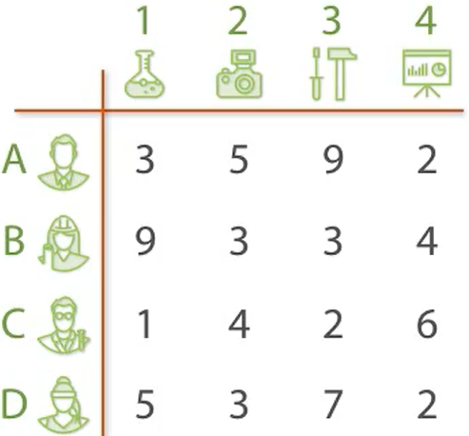
The Job Assignment Problem

Slide 50
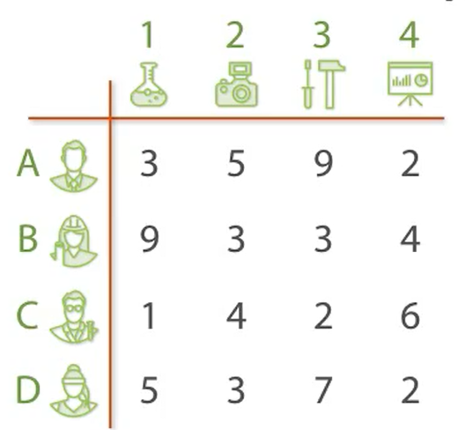
The Task Assignment Problem
Best so far: ∞

Slide 51
The Task Assignment Problem
Best so far: 10
(1, 2, 3, 4)

Slide 52

The Task Assignment Problem
1
2
3
4
Best so far: 10
(1, 2, 3, 4)

Slide 53
The Task Assignment Problem
LB :9
1
2
3
4
Best so far: 10
(1, 2, 3, 4)

Slide 54
The Task Assignment Problem
LB :9
LB :11
1
2
3
4
Best so far: 10
(1, 2, 3, 4)

Slide 55
The Task Assignment Problem
LB :9
LB :11
LB :15
1
2
3
4
Best so far: 10
(1, 2, 3, 4)

Slide 56
The Task Assignment Problem
LB :9
LB :11
LB :15
LB :8
1
2
3
4
Best so far: 10
(1, 2, 3, 4)

Slide 57
The Task Assignment Problem
LB :9
LB :11
LB :15
LB :8
1
2
3
4
Best so far: 10
(1, 2, 3, 4)
Priority queue
1…, LB:9
4…, LB:8

Slide 58
The Task Assignment Problem
4…, LB:8
LB :9
LB :11
LB :15
LB :8
1
2
3
4
1
2
3
Best so far: 10
(1, 2, 3, 4)
Priority queue
1…, LB:9

Slide 59
The Task Assignment Problem
4…, LB:8
LB :9
LB :11
LB :15
LB :8
1
2
3
4
LB :14
1
2
3
Best so far: 10
(1, 2, 3, 4)
Priority queue
1…, LB:9

Slide 60
The Task Assignment Problem
4…, LB:8
LB :9
LB :11
LB :15
LB :8
1
2
3
4
LB :14
LB :8
1
2
3
Best so far: 10
(1, 2, 3, 4)
Priority queue
1…, LB:9

Slide 61
The Task Assignment Problem
LB :9
LB :11
LB :15
LB :8
1
2
3
4
LB :14
LB :8
LB :8
1
2
3
Best so far: 10
(1, 2, 3, 4)
Priority queue
1…, LB:9

Slide 62
The Task Assignment Problem
LB :9
LB :11
LB :15
LB :8
1
2
3
4
LB :14
LB :8
LB :8
1
2
3
Best so far: 10
(1, 2, 3, 4)
Priority queue
1…, LB:9
4,3…, LB:8
4,2…, LB:8

Slide 63
The Task Assignment Problem
4,2…, LB:8
LB :9
LB :11
LB :15
LB :8
1
2
3
4
LB :14
LB :8
LB :8
1
2
3
Best so far: 10
(1, 2, 3, 4)
1
3
Priority queue
1…, LB:9
4,3…, LB:8

Slide 64
The Task Assignment Problem
4,2…, LB:8
LB :9
LB :11
LB :15
LB :8
1
2
3
4
LB :14
LB :8
LB :8
1
2
3
Best so far: 10
LB :8
(1, 2, 3, 4)
1
3
Priority queue
1…, LB:9
4,3…, LB:8

Slide 65
The Task Assignment Problem
4,2…, LB:8
LB :9
LB :11
LB :15
LB :8
1
2
3
4
LB :14
LB :8
LB :8
1
2
3
Best so far: 10
LB :8
LB :9
(1, 2, 3, 4)
1
3
Priority queue
1…, LB:9
4,3…, LB:8

Slide 66
The Task Assignment Problem
LB :9
LB :11
LB :15
LB :8
1
2
3
4
LB :14
LB :8
LB :8
1
2
3
Best so far: 10
LB :8
LB :9
(1, 2, 3, 4)
1
3
Priority queue
1…, LB:9
4,3…, LB:8
4,2,1…, LB:8
4,2,3…, LB:8

Slide 67
The Task Assignment Problem
4,3…, LB:8
LB :9
LB :11
LB :15
LB :8
1
2
3
4
LB :14
LB :8
1
2
LB :8
3
Best so far: 10
LB :8
LB :9
(1, 2, 3, 4)
1
3
Priority queue
1…, LB:9
4,2,1…, LB:8
4,2,3…, LB:8

Slide 68
The Task Assignment Problem
4,3…, LB:8
LB :9
LB :11
LB :15
LB :8
1
2
3
4
LB :14
LB :8
1
2
LB :8
3
Best so far: 10
LB :8
LB :9
LB :8
(1, 2, 3, 4)
1
3
1
2
Priority queue
1…, LB:9
4,2,1…, LB:8
4,2,3…, LB:8

Slide 69
The Task Assignment Problem
4,3…, LB:8
LB :9
LB :11
LB :15
LB :8
1
2
3
4
LB :14
LB :8
1
2
LB :8
3
Best so far: 10
LB :8
LB :9
LB :8
LB :11
(1, 2, 3, 4)
1
3
1
2
Priority queue
1…, LB:9
4,2,1…, LB:8
4,2,3…, LB:8

Slide 70
The Task Assignment Problem
LB :9
LB :11
LB :15
LB :8
1
2
3
4
LB :14
LB :8
1
2
LB :8
3
Best so far: 10
LB :8
LB :9
LB :8
LB :11
(1, 2, 3, 4)
1
3
1
2
Priority queue
1…, LB:9
4,2,1…, LB:8
4,2,3…, LB:8
4,3,1…, LB:8

Slide 71
The Task Assignment Problem
4,2,1…, LB:8
LB :9
LB :11
LB :15
LB :8
1
2
3
4
LB :14
LB :8
1
2
LB :8
3
Best so far: 10
LB :8
LB :9
LB :8
LB :11
(1, 2, 3, 4)
1
3
1
2
Priority queue
1…, LB:9
LB :13
4,2,3…, LB:8
3
4,3,1…, LB:8

Slide 72
The Task Assignment Problem
LB :9
LB :11
LB :15
LB :8
1
2
3
4
LB :14
LB :8
1
2
LB :8
3
Best so far: 10
LB :8
LB :9
LB :8
LB :11
(1, 2, 3, 4)
1
3
1
2
Priority queue
1…, LB:9
LB :13
4,2,3…, LB:8
3
4,3,1…, LB:8

Slide 73
The Task Assignment Problem
4,3,1…, LB:8
LB :9
LB :11
LB :15
LB :8
1
2
3
4
LB :14
LB :8
1
2
LB :8
3
Best so far: 10
LB :8
LB :9
LB :8
LB :11
(1, 2, 3, 4)
1
3
1
2
Priority queue
1…, LB:9
LB :13
LB :9
4,2,3…, LB:8
3
2

Slide 74
The Task Assignment Problem
LB :9
LB :11
LB :15
LB :8
1
2
3
4
LB :14
LB :8
1
2
LB :8
3
Best so far: 9
LB :8
LB :9
LB :8
LB :11
(4,3,1,2)
1
3
1
2
Priority queue
1…, LB:9
LB :13
LB :9
4,2,3…, LB:8
3
2

Slide 75
The Task Assignment Problem
1…, LB:9
LB :9
LB :11
LB :15
LB :8
1
2
3
4
LB :14
LB :8
1
2
LB :8
3
Best so far: 9
LB :8
LB :9
LB :8
LB :11
(4,3,1,2)
1
3
1
2
Priority queue
LB :13
LB :9
4,2,3…, LB:8
3
2

Slide 76
The Task Assignment Problem
4,2,3…, LB:8
LB :9
LB :11
LB :15
LB :8
1
2
3
4
LB :14
LB :8
1
2
LB :8
3
Best so far: 9
LB :8
LB :9
LB :8
LB :11
(4,3,1,2)
1
3
1
2
Priority queue
LB :13
LB :9
3
2

Slide 77
The Task Assignment Problem
LB :9
LB :11
LB :15
LB :8
1
2
3
4
LB :14
LB :8
1
2
LB :8
3
LB :8
LB :9
LB :8
LB :11
Best so far: 9
1
3
1
2
(4,3,1,2)
LB :13
LB :9
Priority queue
3
2

Slide 78
Analysis
Assume n agents and n tasks.
  n possible task assignments to first agent followed by n-1 assignments to the next agent.
  n *n-1*n-2 …
  Θ(n!)
Branch and bound improvement
  Depends on the concrete problem and the bounding function.

Slide 79
The 0/1 knapsack problem

Slide 80
LC Branch-and-Bound
Least Cost(LC) Search
  A search strategy that uses a cost function c(x) to select the next E-node
    would always choose for its next E-node a live node with least cost.
An LC-search coupled with bounding functions is called an LC branch-and-bound search.

Slide 81
The 0/1 knapsack problem
Positive integer
  Profit: P₁, P₂, …, P_{n}
  Weight: W₁, W₂, …, W_{n}
  Capacity: M
Maximize
Constraint:
X_{i} = 0 or 1, i =1, …, n.
Converting the problem to minimization
Minimize:

Slide 82
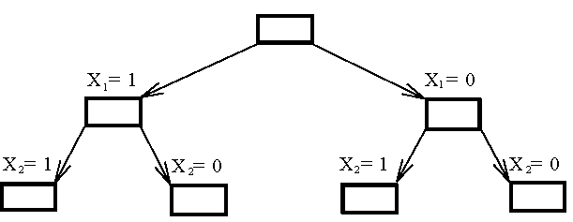
The 0/1 knapsack problem
The Branching Mechanism for the Knapsack Problem.

Slide 83
How to expand the tree?
The best-first search scheme
expand the node with the best lower bound.
If two nodes have the same lower bounds
  expand the node with the lower upper bound.

Slide 84
How to find the upper bound?
Ans:
by quickly finding a feasible solution in a greedy manner:
  starting from the smallest available i, scanning towards the largest i’s until M is exceeded.
  The upper bound can be calculated.

Slide 85
The 0/1 knapsack problem
E.g. n = 6, M = 34
i
1
2
3
4
5
6
P_{i}
6
10
4
5
6
4
W_{i}
10
19
8
10
12
8
(P_{i}/W_{i} ≥ P_{i+1}/W_{i+1})
i
1
2
3
4
5
6
P_{i}/ W_{i}
0.6
0.53
0.5
0.5
0.5
0.5
A feasible solution?

Slide 86
The 0/1 knapsack problem
E.g. n = 6, M = 34
i
1
2
3
4
5
6
P_{i}
6
10
4
5
6
4
W_{i}
10
19
8
10
12
8
(P_{i}/W_{i} ≥ P_{i+1}/W_{i+1})
A feasible solution:
  x₁ = 1, x₂ = 1, x₃ = 0, x₄ = 0, x₅ = 0, x₆ = 0
  -(p₁+p₂) = -16 (upper bound)
Any solution higher than -16 can not be an optimal solution.

Slide 87
How to find the lower bound?
Ans:
by relaxing our restriction from X_{i} = 0 or 1 to 0 ≤ X_{i} ≤ 1 (knapsack problem)

Slide 88
The knapsack problem
i | 1 | 2 | 3 | 4 | 5 | 6
P_{i} | 6 | 10 | 4 | 5 | 6 | 4
W_{i} | 10 | 19 | 8 | 10 | 12 | 8
We can use the greedy method to find an optimal solution for knapsack problem.
For example, for the state of x₁=1 and x₂=1, we have
  x₁ = 1, x₂ =1,
  x₃ = (34 -10 - 19)/8 = 5/8,
  x₄ = 0, x₅ = 0, x₆ = 0
-(p₁+p₂+5/8p₃) = -18.5 (lower bound)
-18 is our lower bound.
  consider only integers for a 0/1 knapsack problem.)

Slide 89
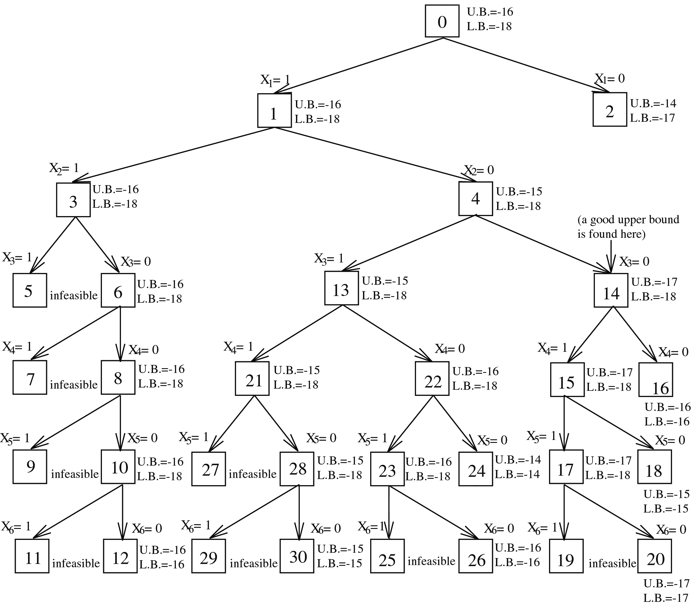
i | 1 | 2 | 3 | 4 | 5 | 6
P_{i} | 6 | 10 | 4 | 5 | 6 | 4
W_{i} | 10 | 19 | 8 | 10 | 12 | 8
For the state of x₁=0 and x₂=1, x₃ = 1, we have
  x₁ = 0, x₂ =1, x₃ = 1,
  -(p₂ + p₃) = -(10 + 4) = -14 (UB)
  x₄ = (34 -19 - 8)/10 = 7/10,
  x₅ = 0, x₆ = 0
-(UB + 7/10p₄) = -17 (LB)

Slide 90
i | 1 | 2 | 3 | 4 | 5 | 6
P_{i} | 6 | 10 | 4 | 5 | 6 | 4
W_{i} | 10 | 19 | 8 | 10 | 12 | 8
  x₁ = 1, x₂ = 0, x₃ = 1, x₄ = 1
  -(p₁ +p₃ +p₄) = -(6 + 4 + 5) = -15 (UB)
  x₅ = (34 -10 – 8 - 10)/12 = 6/12,
  x₆ = 0
-(UB+6/12p₅) = -18 (LB)

Slide 91
i | 1 | 2 | 3 | 4 | 5 | 6
P_{i} | 6 | 10 | 4 | 5 | 6 | 4
W_{i} | 10 | 19 | 8 | 10 | 12 | 8

Slide 92
Node 2 is terminated because its lower bound is equal to the upper bound of node 14.
Nodes 16, 18 and others are terminated because the local lower bound is equal to the local upper bound.
(lower bound ≤ optimal solution ≤ upper bound)

Slide 93
The knapsack problem
Algorithm Bound(cp,cw,k)
//cp, cw are current profit and current weight
//k is the idex of the last removed item
{
b:= cp; c= cw;
for i:= k + 1 to n do
{
c:= c + w[i];
if(c < m) then b:= b + p[i];
else return b + (1 – (c-m)/w[i])*p[i];
}
return b;
}

Slide 94
The knapsack problem
Algorithm Ubound(cp,cw,k,w)
//cp, cw are current profit and current weight
//k is the idex of the last removed item
{
b:= cp; c= cw;
for i:= k + 1 to n do
{
if(c + w[i] <= m) then
{
c:= c + w[i];
b:= b – p[i];
}
}
}

Slide 95
knapsack problem: m =15
i | 1 | 2 | 3 | 4
P_{i} | 10 | 10 | 12 | 18
W_{i} | 2 | 4 | 6 | 9
P_{i}/W_{i} | 5 | 2.5 | 2 | 2
 | 1 | 1 | 1 | 0
x₁ = 1, x₂ =1, x₃ =1
upper bound : -(p₁ + p₂ + p3 ) = - 32
x₄ = (15-2-4-6)/9 = 1/3
lower bound : -(p₁ + p₂ + p3 + 1/3p₄) = - 38

Slide 96
knapsack problem: m =15
i | 1 | 2 | 3 | 4
P_{i} | 10 | 10 | 12 | 18
W_{i} | 2 | 4 | 6 | 9
1
LB:
-38
UB:
-32
x₁= 1
x₁= 0
2
LB:
-38
3
LB:
-32
UB:
-32
UB:
-22
x₂= 1
x₂= 0
4
LB:
-38
5
LB:
-36
UB:
-32
UB:
-22
x₃= 1
x₃= 0
6
LB:
-38
7
LB:
-38
UB:
-32
UB:
-38
x₄= 1
x₄= 0
8
LB:
-38
9
LB:
-20
UB:
-38
UB:
-20

Slide 97
knapsack problem: m =15
i | 1 | 2 | 3 | 4
P_{i} | 10 | 10 | 12 | 18
W_{i} | 2 | 4 | 6 | 9
1
LB:
-38
UB:
-32
x₁= 1
x₁= 0
2
LB:
-38
3
LB:
-32
UB:
-32
UB:
-22
x₁ = 0, x₂ =1, x₃ =1
upper bound : - ( p₂ + p3 ) = - 22
x₄ = (15-4-6)/9 = 5/9
lower bound : - (p₂ + p3 + 5/9p₄) = - 32

Slide 98
knapsack problem: m =15
i | 1 | 2 | 3 | 4
P_{i} | 10 | 10 | 12 | 18
W_{i} | 2 | 4 | 6 | 9
1
LB:
-38
UB:
-32
x₁= 1
x₁= 0
2
LB:
-38
3
LB:
-32
UB:
-32
UB:
-22
x₂= 1
x₂= 0
4
LB:
-38
5
LB:
-36
UB:
-32
UB:
-22
x₁ = 1, x₂ =0, x₃ =1
upper bound : - (p₁ + p3 ) = - 22
x₄ = (15-2-6)/9 = 7/9
lower bound : - (p₁ + p3 + 5/9p₄) = - 36

Slide 99
knapsack problem: m =15
i | 1 | 2 | 3 | 4
P_{i} | 10 | 10 | 12 | 18
W_{i} | 2 | 4 | 6 | 9
1
LB:
-38
UB:
-32
x₁= 1
x₁= 0
2
LB:
-38
3
LB:
-32
UB:
-32
UB:
-22
x₂= 1
x₂= 0
4
LB:
-38
5
LB:
-36
UB:
-32
UB:
-22
x₃= 1
x₃= 0
LB:
-38
LB:
-38
x₁=1, x₂=1,
x₃=0, x₄=0
6
7
UB:
-32
UB:
-38
upper bound : - (p₁ + p2 + p₄ ) = - 38

Slide 100
knapsack problem: m =15
i | 1 | 2 | 3 | 4
P_{i} | 10 | 10 | 12 | 18
W_{i} | 2 | 4 | 6 | 9
1
LB:
-38
UB:
-32
x₁= 1
x₁= 0
2
LB:
-38
3
LB:
-32
UB:
-32
UB:
-22
x₂= 1
x₂= 0
4
LB:
-38
5
LB:
-36
UB:
-32
UB:
-22
x₃= 1
x₃= 0
LB:
-38
LB:
-38
x₁=1, x₂=1,
x₃=0, x₄=1
6
7
UB:
-32
UB:
-38
x₄= 1
LB:
-38
upper bound : - (p₁ + p2 + p₄ ) = - 38
8
UB:
-38

Slide 101
knapsack problem: m =15
i | 1 | 2 | 3 | 4
P_{i} | 10 | 10 | 12 | 18
W_{i} | 2 | 4 | 6 | 9
1
LB:
-38
UB:
-32
x₁= 1
x₁= 0
2
LB:
-38
3
LB:
-32
UB:
-32
UB:
-22
x₂= 1
x₂= 0
4
LB:
-38
5
LB:
-36
UB:
-32
UB:
-22
x₃= 1
x₃= 0
x₁=1, x₂=1,
x₃=0, x₄=0
6
LB:
-38
7
LB:
-38
UB:
-32
UB:
-38
upper bound :
- (p₁ + p2 ) = - 20
x₄= 1
x₄= 0
8
LB:
-38
9
LB:
-20
UB:
-38
UB:
-20

